Slide 1
The Call to Leadership
Notes:
Welcome To New Hope Town’s Leadership Training School!!!

Slide 2
Agenda
Praise and worship
Welcome/Introduction
Challenge/prayer
Teaching – Call of Leadership Session I
Break
Teaching – Call of Leadership Session II
Action List
Distribute Materials
Receive $15.00 per Student
Meal Assignments for Following Weeks
Close with prayer.

Slide 3
Welcome to LTS
Welcome to the “Stretch for God”!
  LTS Basics is a 3 week intensive training program designed to equip everyday people who love God for ministry leadership.
  LTS GG is a 4 week intensive training program designed to equip leaders to specifically lead NHT GG’s. This course immediately follows LTS Basics.
  Each week we have 2 teachings and for homework you’ll read a book and potentially listen to an audio sermon and complete study worksheets for both.
  We’ll fast as a group on the day of our meeting
Prayer for Students and Teachers!

Slide 4
God’s End Time Purpose
Joel 2:28-29, ”And it shall come to pass afterward That I will pour out My Spirit on all flesh; Your sons and your daughters shall prophesy, Your old men shall dream dreams, Your young men shall see visions."
God's purposes are now!
  Acts 2:14-17 (verse 16), “But this is that which was spoken by the prophet Joel:”
God's purposes are for all mankind. (Joel 2:28)
WHAT IS HE AFTER??
Notes:
Day of Joel reality! Prophet, priest and king only ones to receive Spirit. What is the premise? There is no way you can stand to minister to God’s people and bring them into their purpose without the literal presence and power of God upon your life.
Joel 2:28-29 Joel predicted the spiritual revival before the day of Pentecost
Acts 2:14-17 Peter addressed the crowd, re-iterating the prophesy in Joel 2:28 as being fulfilled by the events of the day of Pentecost.
God’s point: in that day, what only a p, p or k had will be needed by all! To see His redemptive will be done an ARMY OF SPIRIT FILLED SERVANTS will be necessary to redeem, restore and renew.
We are experiencing God’s outpouring of the Holy Spirit today. What is God’s end-time plan?
To raise up a group of men and women to reclaim what was lost at the Garden of Eden … to bring about the Kingdom of God.
Redemption and Restoration.
God wants to restore everything. Not just man but everything.
-------
http://www.biblestudy101.org/definitions/kingdom.html
The kingdom of God is the redemptive rule of God in Christ defeating Satan and the powers of evil and delivering men from the sway of evil. It brings to men "righteousness and peace and joy in the Holy Spirit" (Rom. 14:17). Entrance into the kingdom of Christ means deliverance from the power of darkness (Col. 1:13) and is accomplished by the new birth (John 3:3, 5).
The kingdom is NOT the church. We may say that the kingdom of God creates the church.

Slide 5
God’s Purposes Require
Conflict/Battle
God is “RECAPACITATING” mankind to fulfill His original purpose...His will being done on earth as it is in heaven!
God’s purposes are fought and won by an army!
God’s strategy is revolution
  Revolution: A complete turning around! (turning the present value systems of the world to align with God’s word)
Notes:
God wants to turn around the present value system
In every revolution there must be an army. We are the army. New Hope Town is called to equip and train men and women to attain a revolution in the present value system.
ARMY IS ONLY AS SUCCESSFUL AS THE EQUIPPED LEADERS EQUIPPING OTHER TO DO THE WORK OF WAR.

Slide 6
God’s Purposes Require
Conflict/Battle
Requirements for successful revolution:
  Willingness to die to self (flexibility).
  Physical strength through discipline / T.M.(temple maintenance)
  Vision for the future.
  Mobility (ready to move, and ready for action).
  Radical commitment to the cause.
    Radical: fundamental, down to the root.
Notes:
Qualities/Requirements to achieve a revolution
Being physically fit allows us to perform the call God which may involve physical fitness and strength. Keep you body fit and see how God can use that for his glory
Vision for the Future – we cannot be content with where we are in Christ. We must press into God and press onward towards his call. We must look to the future and prepare, build, plant, harvest!
Willingness to change – if God says it, we need to change. We can do it. Sometimes change is needed to come into obedience to Christ. Sometimes change is simply needed to function in the place where God has planted you … family, work, church. Don’t be resistant to change, be flexible.
Mobility – ready for action. When the Spirit leads, be ready to follow. Moving objects are easier to direct than one that is still.
Radical – Be 100% committed, be sold out for Jesus and his Call, his purposes.

Slide 7
We are the Army
God uses people!
  Luke 6:12-16, “… He chose twelve …” (Note: These were men just like you and me)
God wants to use you!
  You are called!
    2 Tim 1:8-9, “… who has saved us and called us with a holly calling, not according to our works, but according to His own purpose and grace…”
  You are called to active service.
    2 Tim 2:2-4, “… as a good soldier …”
  You are called to go into all the world and change it!
    Matt 28:19, “… Go make disciples of all nations…”
Notes:
We must realize that the Church is more than a spiritual meeting place; the church has a divine destiny and purpose
Luke 6:12-16 – First, Jesus prayed all night, then he chose his twelve disciples. Jesus who was fully God and fully man prayed first and sought the direction, understanding and power of God.
These men were ordinary people.
God uses ordinary people to do extraordinary things
2 Tim 1:8-9 When you are saved, when you give your life to Christ, you are called to some level of leadership. Accept that calling, lead where God has called you, pray for God to show you the steps to accomplish His calling.
2 Tim 2:2-4 We are in active service. We are not spectators sitting on the sidelines, we are participants. We are doers.
Matt 28:19 The Great Commission restated – Go into all the world and change or produce revolution for God’s purposes. Become a World Changer. Allow God to use you to change our World!

Slide 8
We are the Army
Obstacles to personal fulfillment of God’s purposes:
  The nobody complex
    Judges 6:12-16, “… The Lord is with you, you mighty man of valor!”
    Jeremiah 1:4-9, “… Before I formed you in the womb I knew you … For I am with you to deliver you… Behold I have put My words in your mouth.”
    1 Tim 4:12, “Let no one despise your youth, but be an example to the believers in word, in conduct, in love, in spirit, in faith, in purity.”
    God transforms nobody’s into somebody's who change the world!
  The “who me” syndrome
    Exodus 3:10-11
Notes:
2 Reasons people decline leadership:
Nobody Complex –
Look at Gideon in Judges 6:12-16, He was hiding from the Midianites and the Lord says to him “Hello Gideon, you great warrior who will conquer your enemies”. God saw something that was not obvious. Imagine God calling you a man of valor while you are hiding. Gideon felt unqualified and at that moment was unqualified. But after testing the word from God, he obeyed, he lead his people and was exactly what God called him … A man of valor!
Look at Jeremiah in 1:4-9, He says to God that he is unqualified since he is a youth and not able to speak. God assures him that he will be able to stand in front of all who God sends him too and even better, God will put the words in his mouth.
“Who Me” – Exodus 3:10-11 God speaks to Moses from a burning bush and tells Moses that He will send him to Pharaoh to free the Israelites. Moses response is “Who am I …”. God assures him that He will be with him and gives Moses signs to work.
See what God sees in you. Ask God through prayer to open your eyes to His reality of You.
Vision is the ability to see what God desires, what God sees … received through prayer. Sometimes God will give us a vision but may not give us all of the intermediate steps. Write down what God speaks to you and trust him to fill in the rest as it is needed.

Slide 9
We are the Army
He’s calling, will you answer?
  Acts 17: 6-7, “These men who have turned the world upside down have come here also.”
  1 Tim 3:1, “If anyone aspires to leadership, he desires a good work.”
  THIS GOOD WORK OF GOD HAS TO DO WITH MEN AND WOMEN WHO UNDERSTAND HIM AND HIS PURPOSES AND WILL GIVE THEIR LIVES TO SEE IT COME TO PASS
Notes:
God is calling, will you answer?
Answer the call. Be obedient. Trust God. God wants to use us to bring about His Kingdom.
Develop a teachable spirit and learn from God and from others teaching on his behalf
God will help you and be with you as you seek him and depend on him.
Your greatest asset besides Jesus is “You don’t know what you’re doing”. Depend on God, he will show you.

Slide 10

Break Time
Be back in
10 minutes!

Slide 11
Call of Leadership – Part 1 Review
God's end time purposes:
  Joel 2:28-29, ”… I will pour out My Spirit on all flesh..."
  Isaiah 11:9, ”… For the earth shall be full of the knowledge of the Lord as the waters cover the sea.”
We are to be propagators of His purposes!
  Propagator: one who causes something to multiply or reproduce; to breed to spread the knowledge of, to transmit or carry forward.
Notes:
God’s work will go forth. Lets insert ourselves into His work and be used by Him. He is calling us to propagate His purposes.

Slide 12
What we are, we will reproduce!
We cannot impart to others what we do not understand or possess for ourselves.
  Numbers 11:25, “Then the Lord came down in the cloud, and spoke to him, and took of the Spirit that was upon him, and placed the same upon the seventy elders...”
  “You will teach what you know, but you will replicate who you are.” - Pastor Wayne Cordeiro
Notes:
You can only reproduce what you are.
YOU ARE: Psalm 78:73 Skill of hand/Integrity of Heart
1) Kingdom Reps
2) Must walk in integrity and character
People will model or follow the Jesus they see in your life. God will reproduce through you.

Slide 13
What we are, we will reproduce!
Modeling/living examples:
  John 13:14-15, “… I have given you an example … do just as I have done to you."
  I Thess 1:6-7, “And you became imitators of us…”
  Phil. 3:17, ”… join in imitating me …”
  I Tim. 4:12, “… but set the believers an example …”
THE EXAMPLE:
  So he shepherded them according to the integrity of his heart,
  And guided them by the skillfulness of his hands. Psalm 78:72
Notes:
John 13:14-15 Jesus modeled being a servant to His disciples by washing their feet. Jesus taught through everyday life and through targeted examples.
As a leader you are NOT called to be perfect. Remember that you are a “Man or Woman of God”. You are flesh first and then of God. Be yourself, but be ready to change for God and to follow Christ hard so that others who will be watching you will see a real pattern of how to follow Christ. Don’t hide your faults, don’t try to be perfect. If you do, you’ll reproduce perfect people who are not really perfect but have learned how to hide their faults at least as well as you do.

Slide 14
We are Kingdom Representatives
We are called to be His ambassadors.
  II Cor. 5:20, “… we are ambassadors for Christ ..."
  Ambassador: a representative of one government to another; to act on behalf of one’s leader in the exact manner they would … (he speaks on behalf of his government)
Notes:
An ambassador knows who or what he is representing. You cannot be a true ambassador of Christ if you do not know Him. Get on your face, spend time with Jesus in prayer. Know Him and you will then represent Him well.

Slide 15
Our Personal Walk and Integrity
Challenge in personal relationship with God.
Challenge in family relationship.
Challenge in community relationships (i.e. PTA, neighborhood organizations)
Challenge in relationships with those in the world. (i.e.. paying bills, etc.)
Notes:
Expectations of Leaders
Personal relationship with God – A person who is “Spirited is a person who exemplifies the fruits of the spirit”. COMMIT TO DAILY DEVOTIONS and PRAYER. This is your “PRIME TIME”. Do you devotions in the morning before you start your day.
Family relationships – Your family must be in order. Serve together as a team. Pray together, read scripture together.
Husband – leader of the home, responsible to build up the family, spiritual giant at home
Wife – compliment to the husband
Family Altar or Family Devotions are a priority
Integrity in community relationships – Live at peace with your neighbors

Slide 16
Our Personal Walk and Integrity
Challenge in deed/speech.
Challenge in purity, beyond reproach.
  Titus 2:6-8, “… be a model of good works… show integrity… having nothing evil to say about you”
  Titus 1:5-9, “… an overseer, as God’s steward, must be above reproach.”
Notes:
Expectations of Leaders (Continued)
Relationships in the world – Pay your bills on time, obey the laws (e.g.. Speed limits)
Integrity in dead/speech – reflect the character of God. Be men and women of purity. Be beyond reproach. We are not perfect, but we are pressing toward that.
We want to reproduce people with a Heart and Love for God!!!

Slide 17
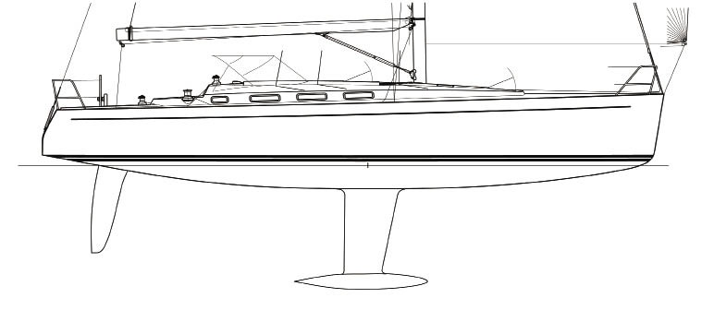
The Leadership Boat!
Gifts, Talents, Abilities - what people see and praise!
CHARACTER
what drives the boat and stays it in storms!
Notes:
A boat with keel is a great picture of our lives and leadership potential.
As with the first picture, God is not only wanting to build you to accomplish things for His Kingdom, but you are being built to help carry other people to their divine purpose as well.
YOUR KEEL, your character, is the number one thing that must be developed AND GOD’s CHIEF FOCUS
YET, its usually, at a young age the thing that is least focused on by us

Slide 18
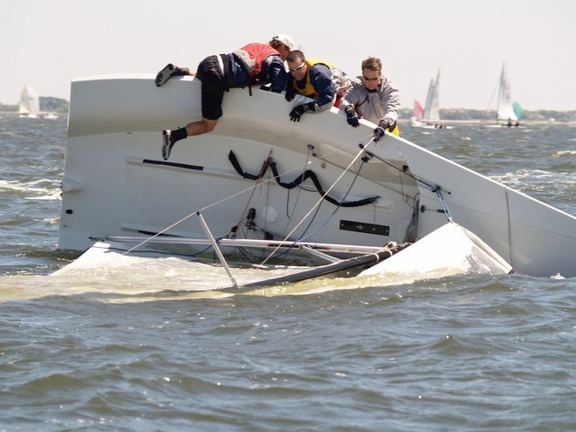
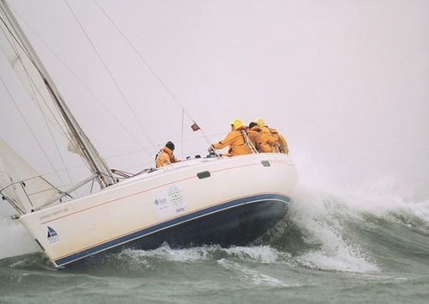
We huli in life!
How’s your keel?
To develop your character, God often sends storms to let us see what our “keel” is made of.
Results of a life focused on gifts, and intentional “keel” work.
Results of a life focused on gifts, but little “keel” work.
Notes:
Thing that can fool you is that you have been promoted and supported according to your gifts.
We often focus on and are driven by our gifts because they come easy and its what we are good at.
We often neglect our character development because it takes hard work, a lot of looking in the mirror at what isn’t good.
WE MUST REMEMBER - God is working on skills AND INTEGRITY!
Told, “let your strengths cover your weaknesses”. This is only half of what is required to be a spiritual leader. Many younger leaders go out with skills and little character and get TOPPLED!

Slide 19

Leadership Wake
Strong Leaders learn how to put the right amount of focus on both
Fruitful Relationship Development
Task Accomplishment

Slide 20

Questions?

Slide 21
Action List (Prep for Next Week)
Have Devotions & Prayer Daily
Read “Prayer is invading the impossible” by Jack Hayford.
Listen to "Seeking God's Face" by Greg Hester.
Use the online worksheet and list all of your strengths and potential strengths, weaknesses and potential weaknesses as a leader.
Memorize Core Values #1, #2, #3, #4 & #5
Be ready for a Core Value Quiz next week!
Complete the Online Discussion Questions
Notes:
It is very important that you complete the items in the ACTION LIST. If you fall behind, it will be hard to catch-up.
There will be a quiz at the start of the sessions

Slide 22
Online Discussion Questions
Each Week, you’ll have 5-10 Online Discussion Questions that we want you to answer BEFORE coming to class next time.
http://lts.newhopetown.org
Notes:
It is very important that you complete the discussion questions before coming to class

Slide 23
Conclude
Receive $$ per Student
  $15 per a LTS Basics student
  $10 per an LTS GG student
Assign Refreshments
Close with prayer.

